Slide 1
Workload-Aware Storage Adaptive partitioning, replication and layouts
Li Yuming
2018/4/18

Slide 2
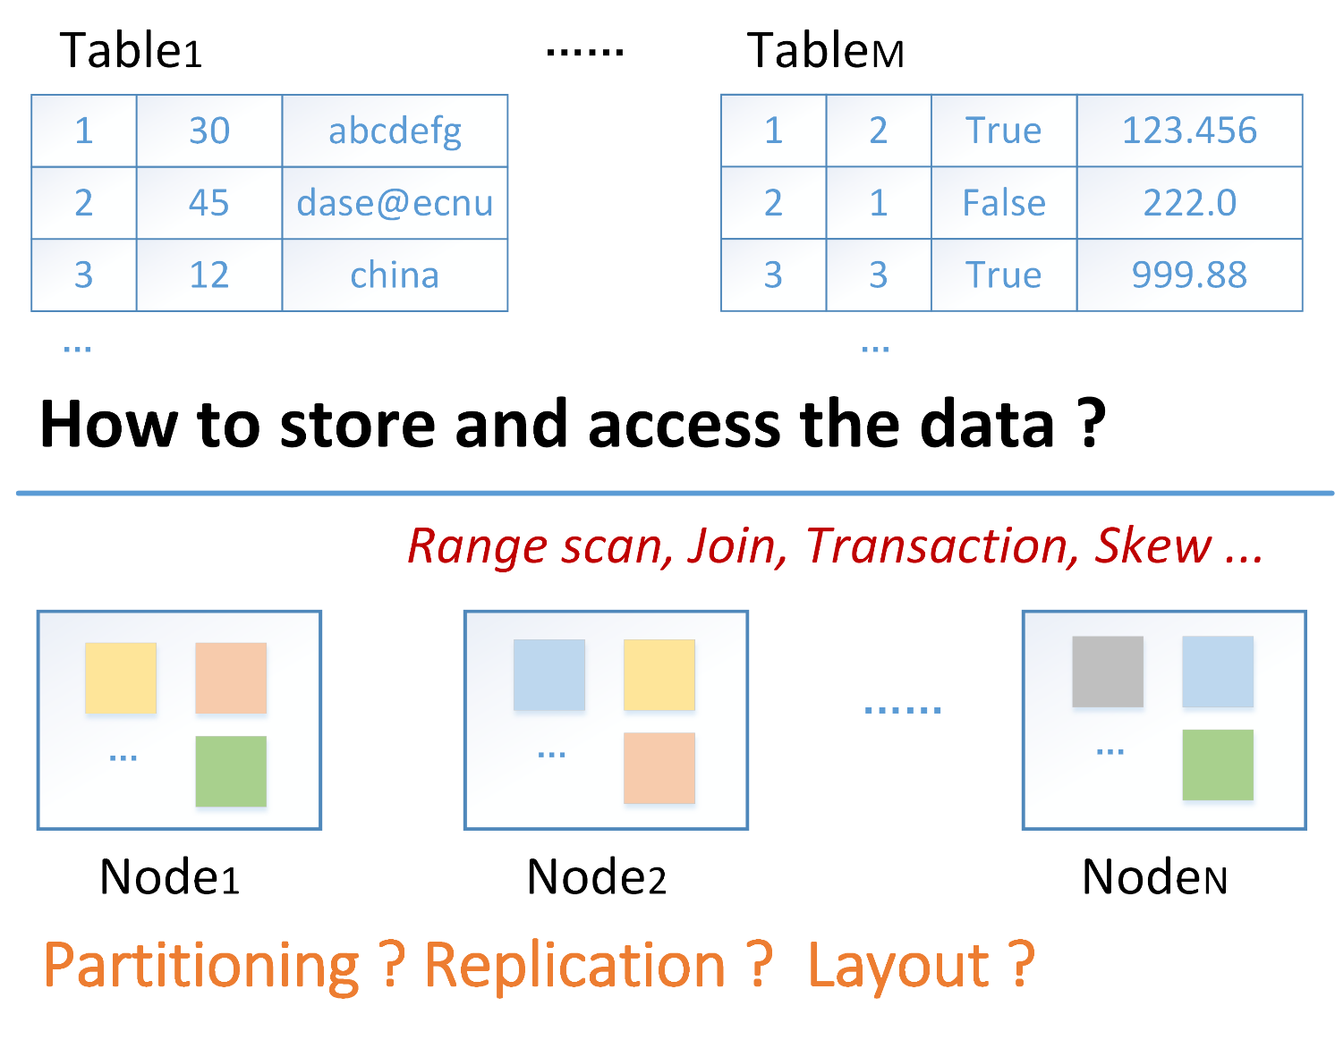
Storage

Slide 3
Partitioning
Round-robin: send each successive tuple to a different partition;
Range: divide up tuples according to a set of predicates (e.g., c1 >= 0 & c1 < 10 & c2 is True);
Hash: assign tuples to partitions by hashing them.

Slide 4
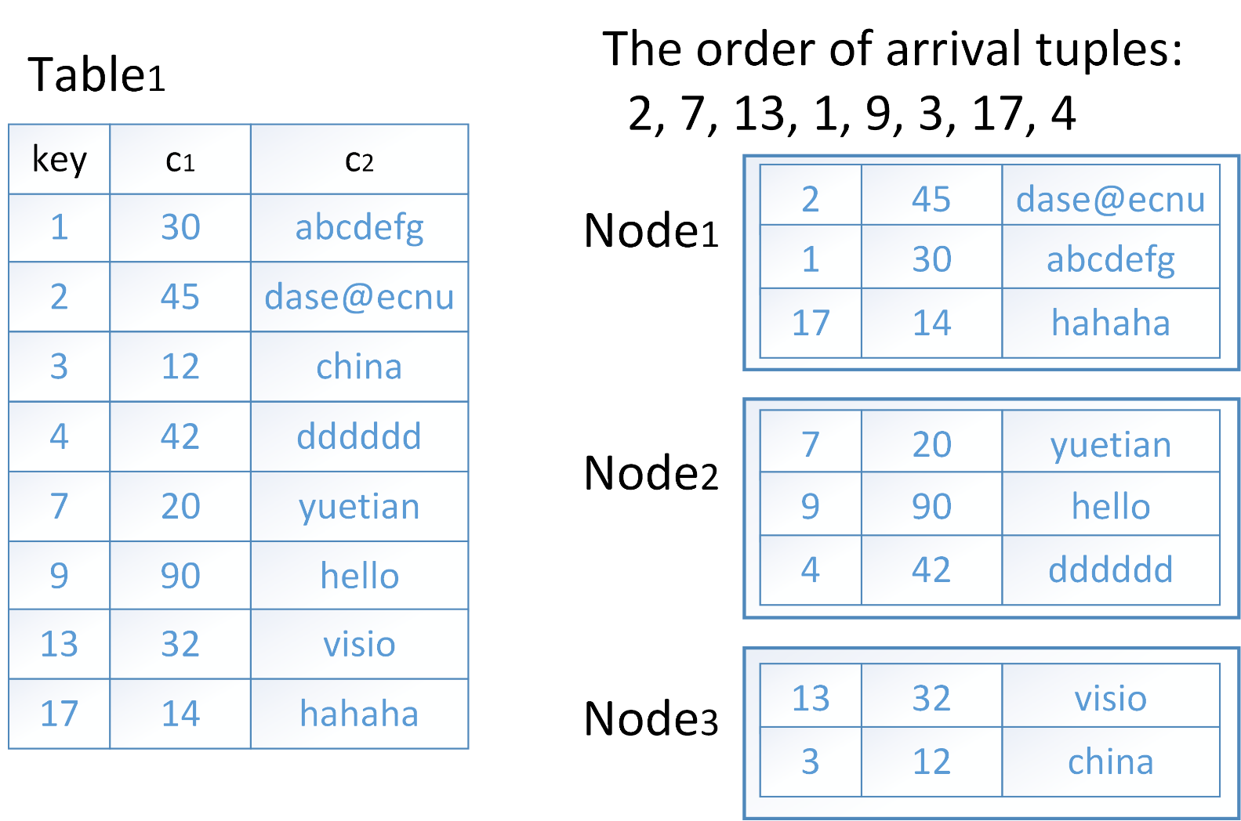
Round-robin

Slide 5
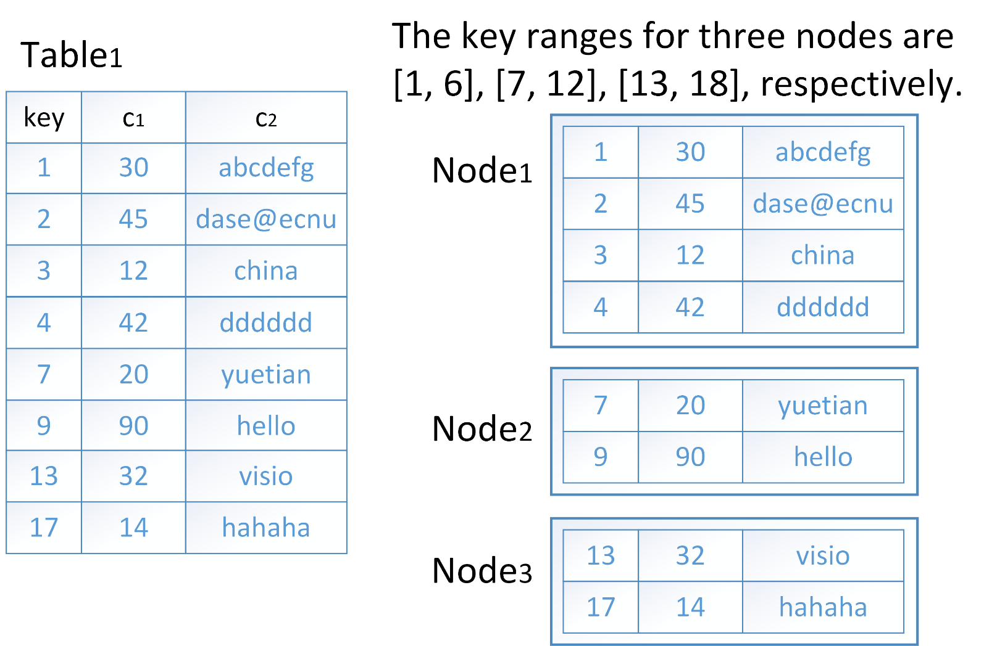
Range

Slide 6
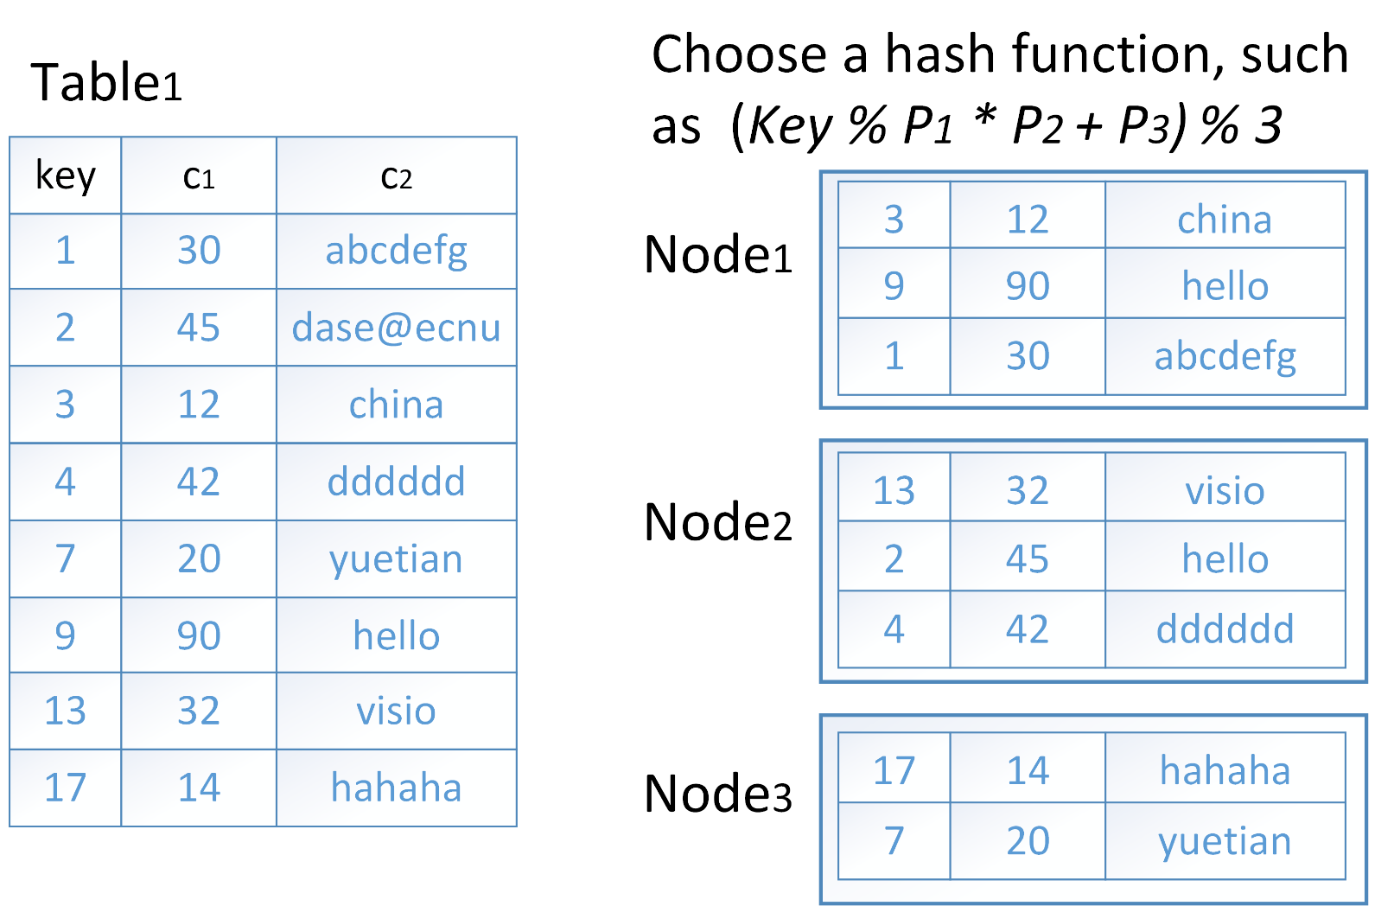
Hash

Slide 7
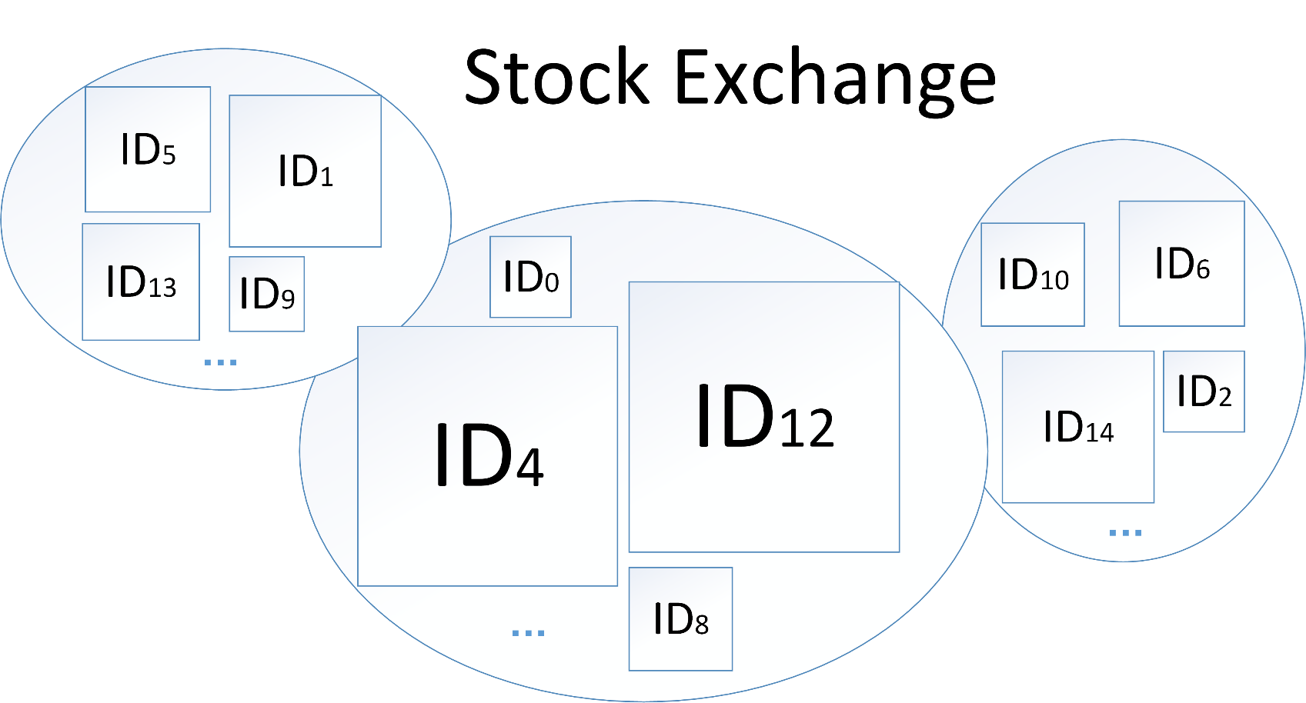
Partitioning & Load balance
Load balance: data, workload.

Slide 8
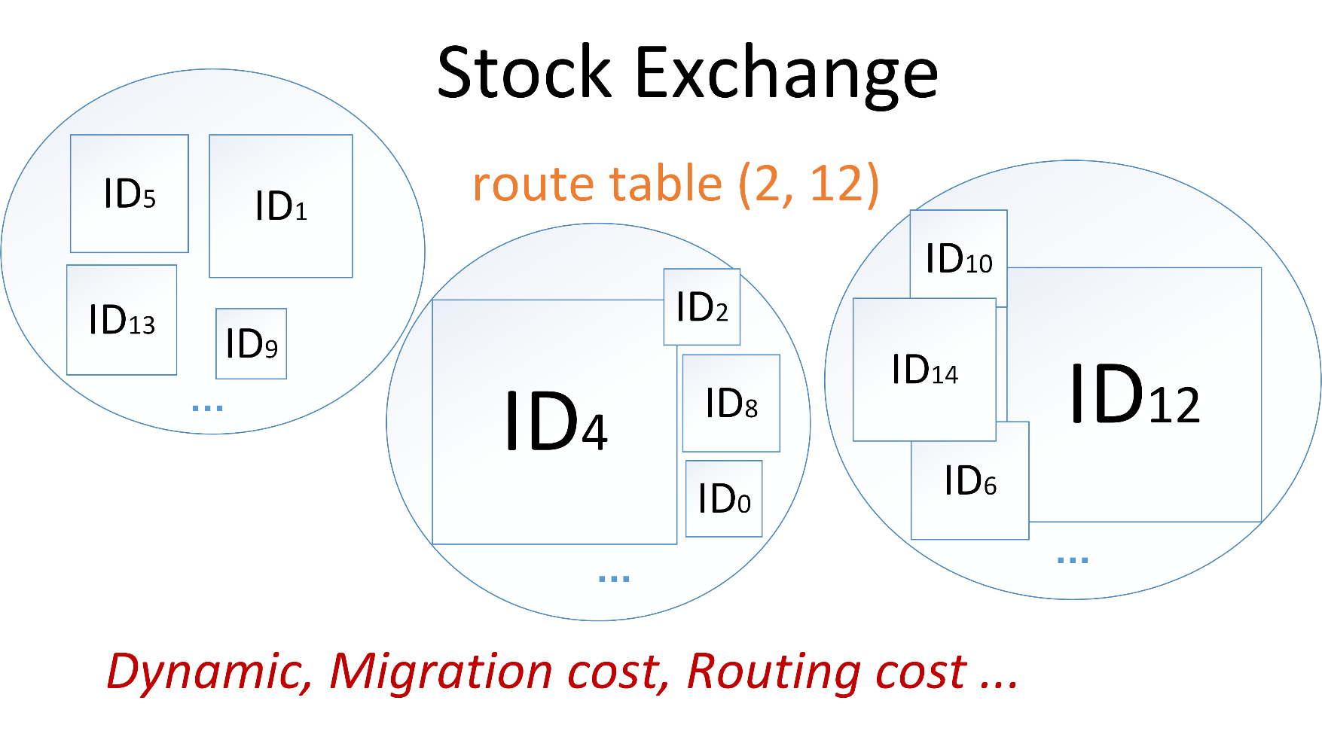
Partitioning & Load balance
Load balance: data, workload.

Slide 9
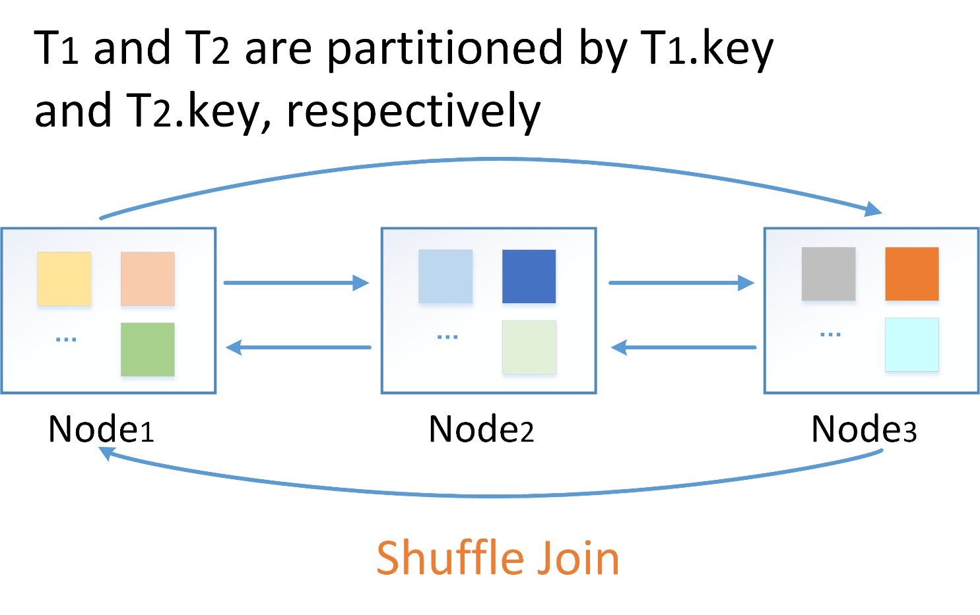
Partitioning & Network transmission
Select * from T1, T2 where T1.key = T2.fk;

Slide 10
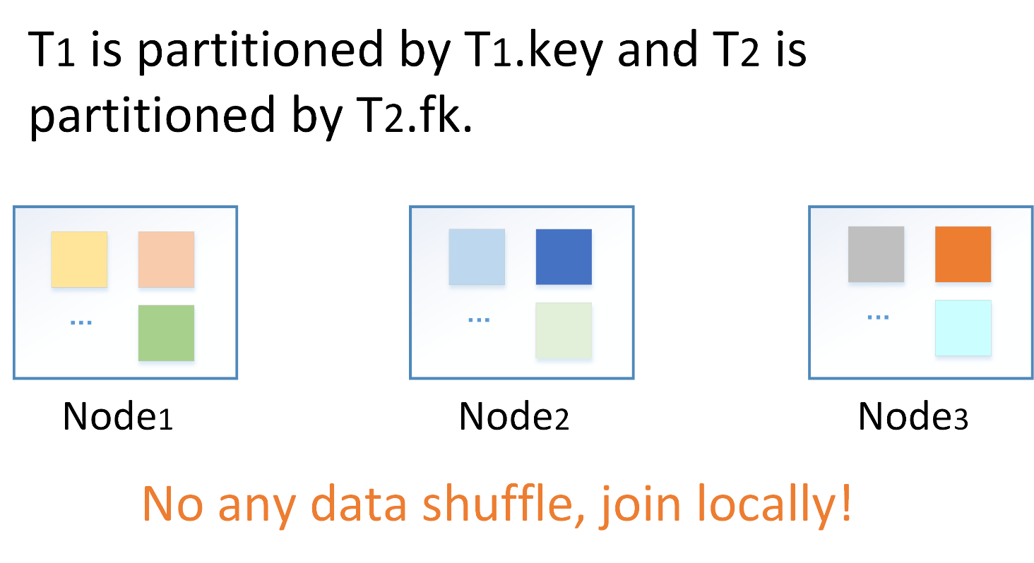
Partitioning & Network transmission
Select * from T1, T2 where T1.key = T2.fk;

Slide 11
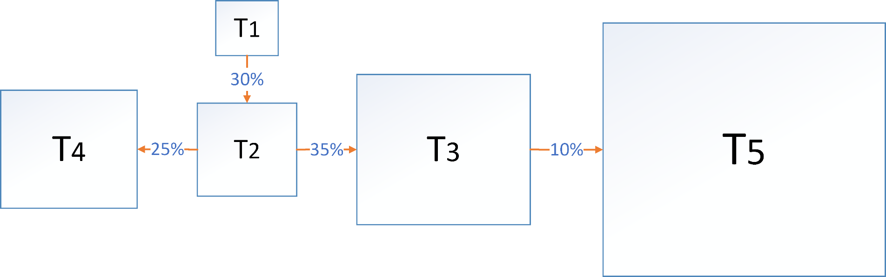
Partitioning & Network transmission
Select * from T1, T2 where T1.key = T2.fk; 30%
Select * from T2, T3 where T2.key = T3.fk; 35%
Select * from T2, T4 where T2.key = T4.fk; 25%
Select * from T3, T5 where T3.key = T5.fk; 10%

Slide 12
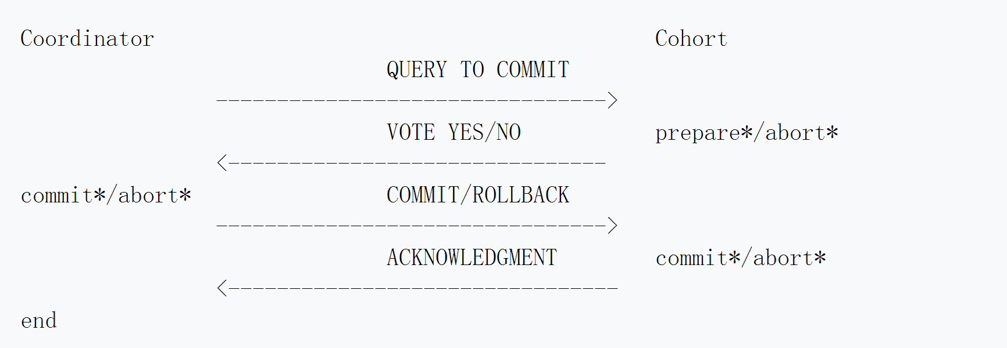
2PC Protocol
The two-phase commit protocol (2PC) is a type of atomic commitment protocol. It is a distributed algorithm that coordinates all the processes that participate in a distributed transaction on whether to commit or abort the transaction.

Slide 13
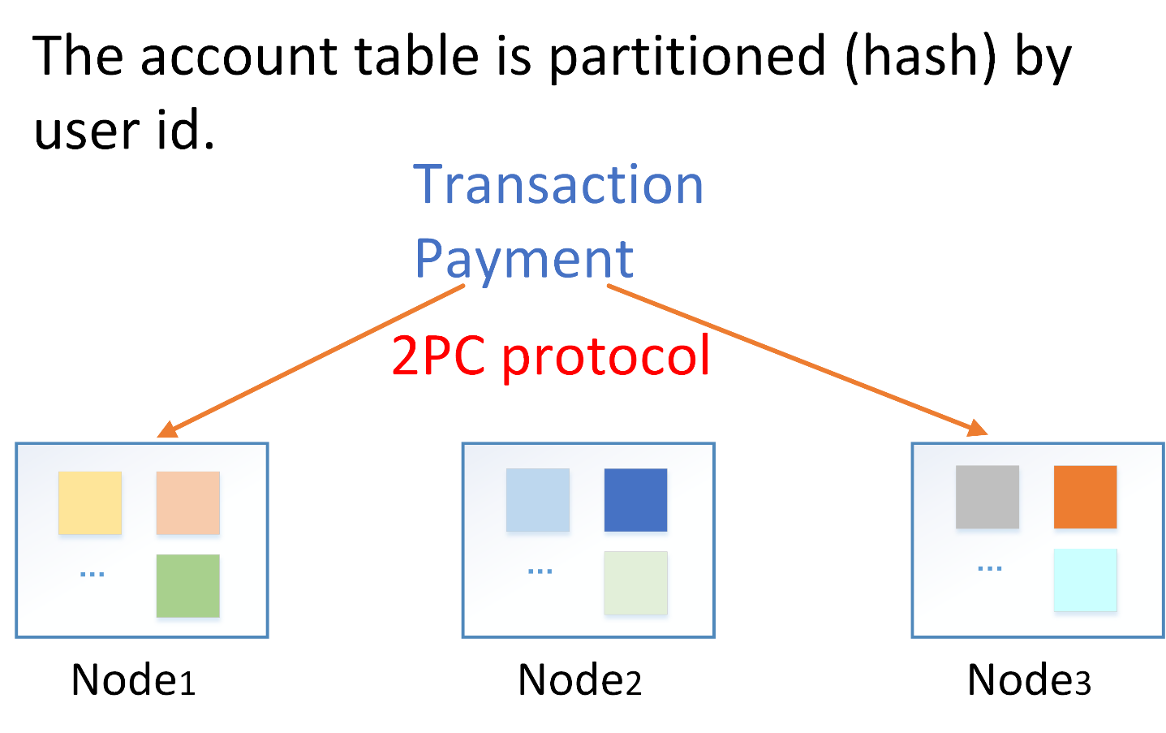
Partitioning & Distributed transaction
Face to face pay, massive users.

Slide 14
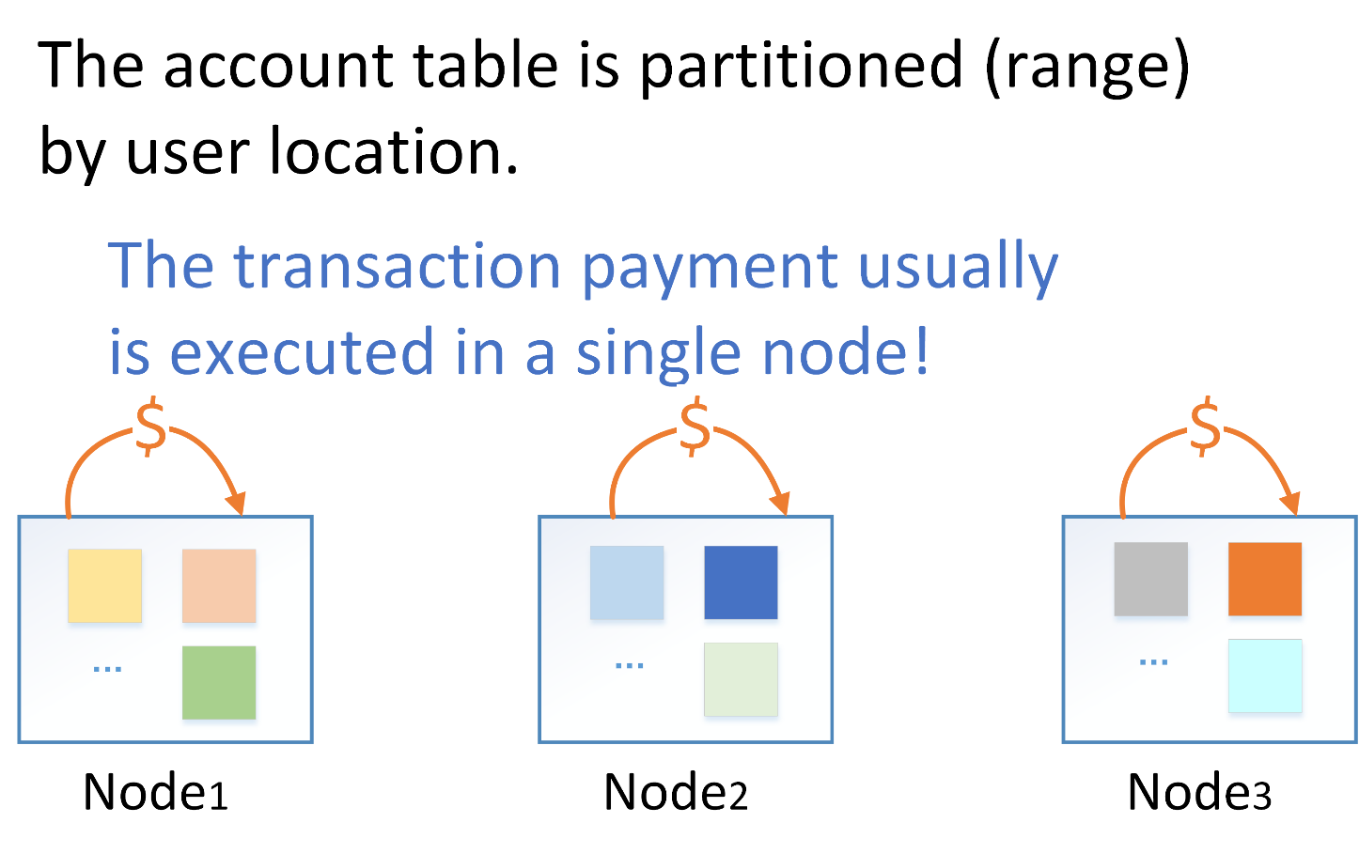
Partitioning & Distributed transaction
Face to face pay, massive users.

Slide 15
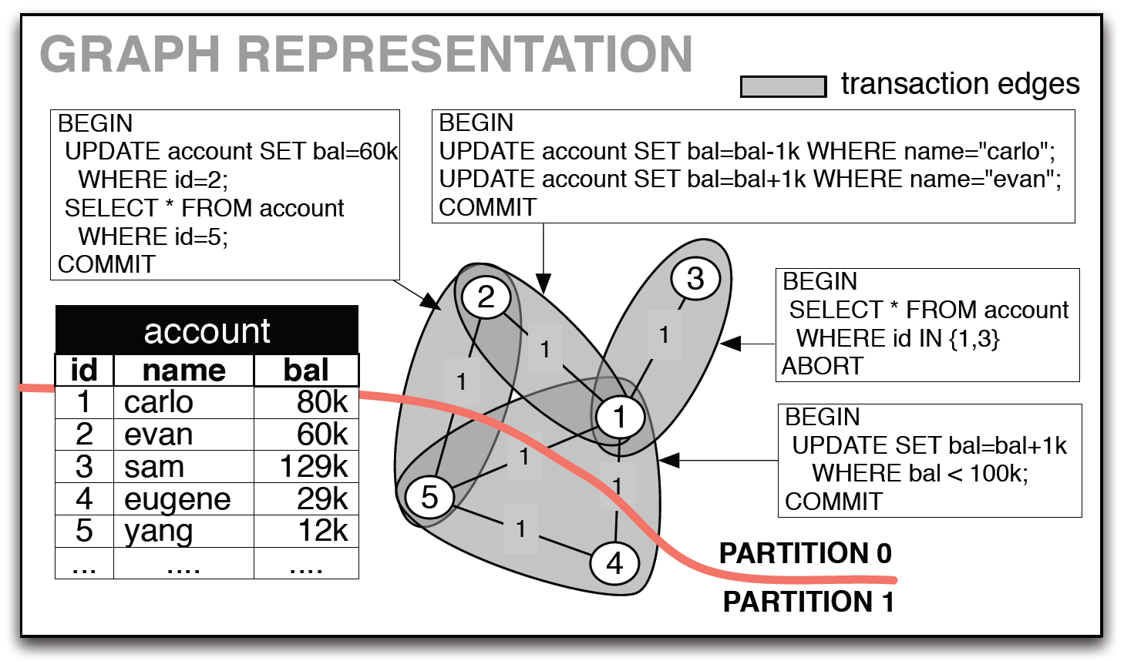
Partitioning & Distributed transaction
Notes:
分布式事务比例（切割的边的权重）
负载均衡
路由代价
Repartition代价

Slide 16
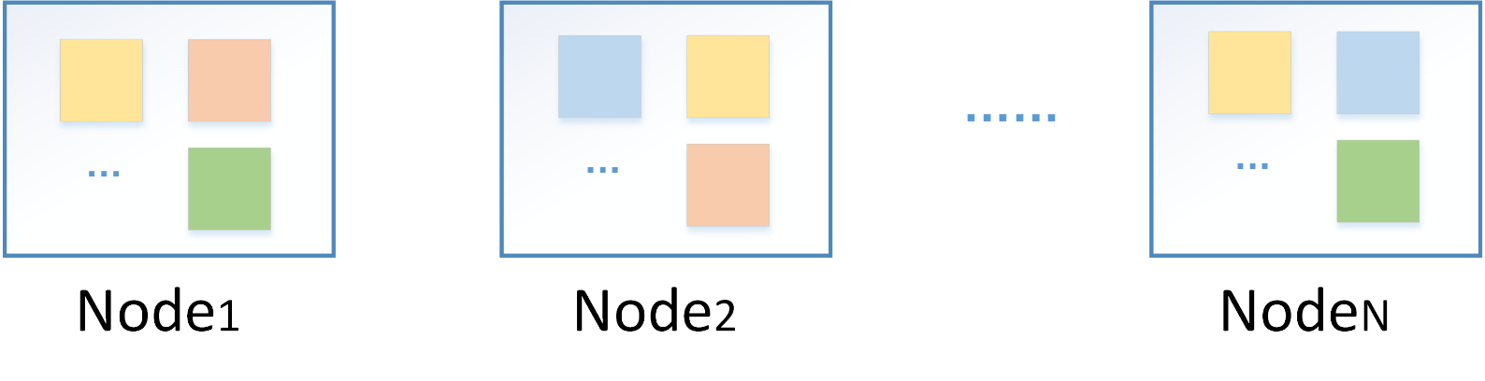
Replication
Replication: the use of redundant resources to improve reliability, fault-tolerance, or performance.
Replication objects: cluster, server, data.
Notes:
data replication if the same data is stored on multiple storage devices,
computation replication if the same computing task is executed many times.
active replication is performed by processing the same request at every replica.
passive replication involves processing each single request on a single replica and then transferring its resultant state to the other replicas.

Slide 17
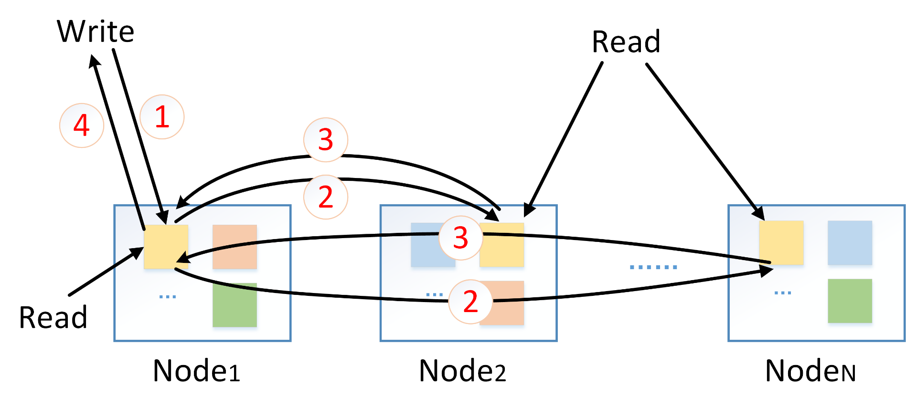
Replication (synchronization)

Slide 18
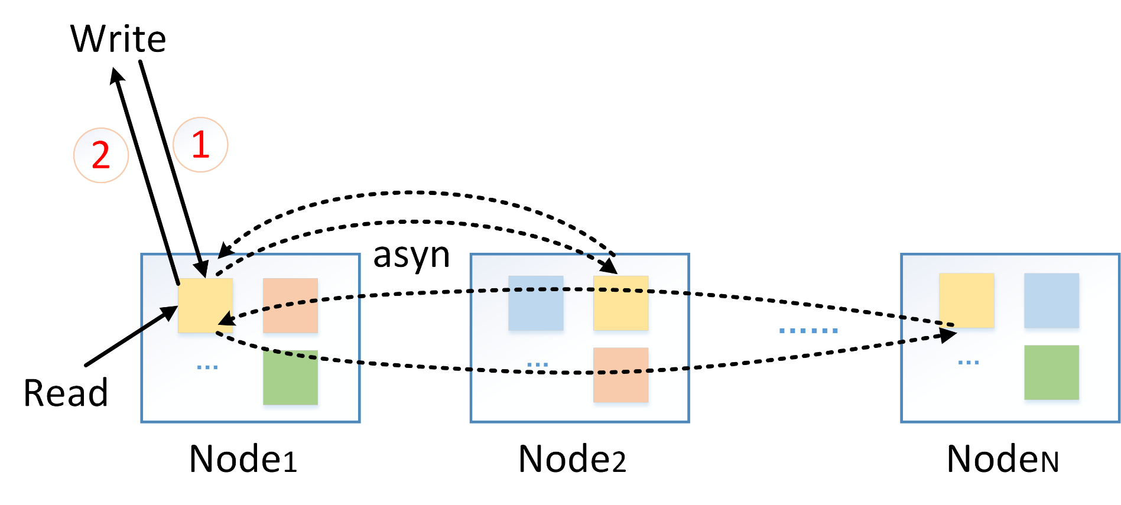
Replication (asynchronization)

Slide 19
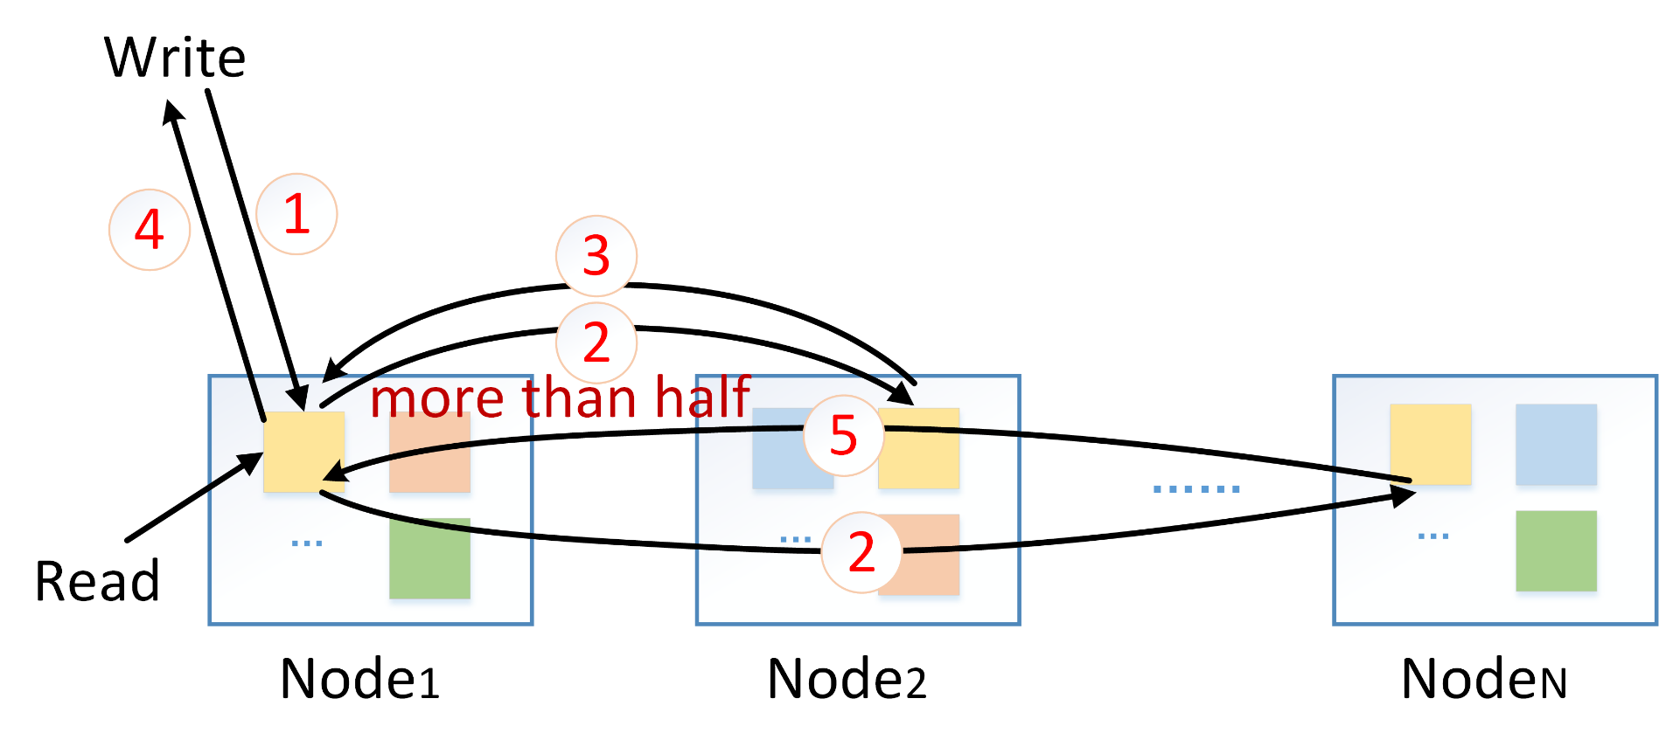
Replication (asynchronization - 2)

Slide 20
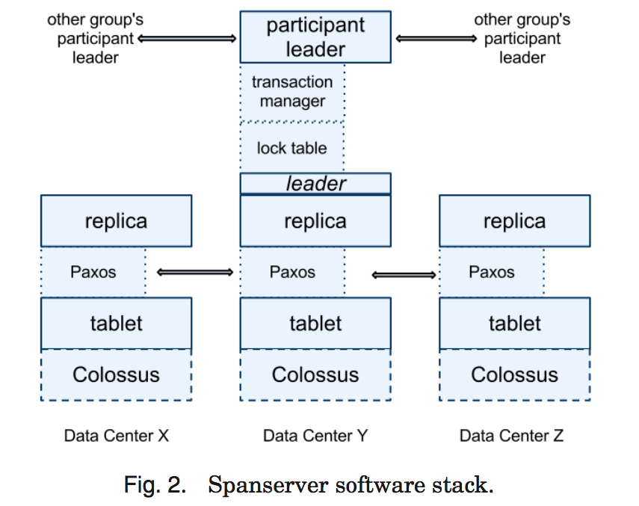
Replication (paxos)

Slide 21
Replication & Network transmission
Select * from T1, T2 where T1.key = T2.fk;
Select * from T2, T3 where T2.key = T3.fk.

Slide 22
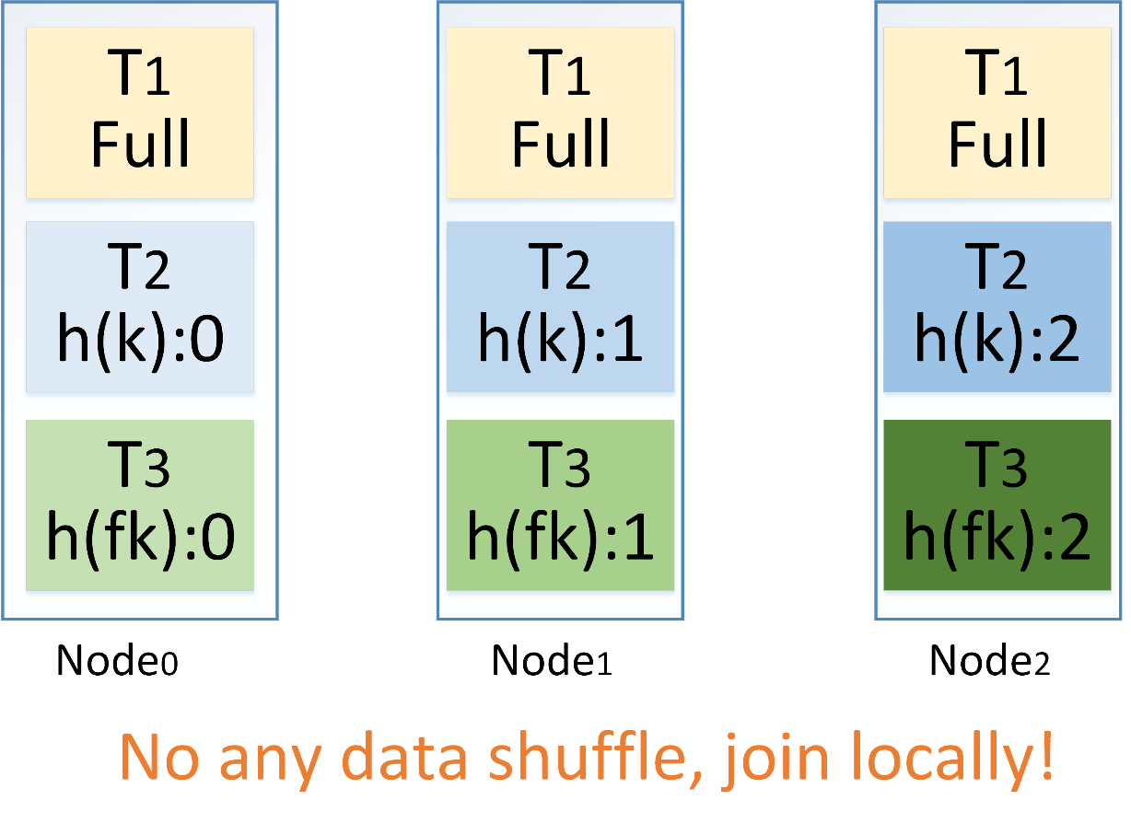
Replication & Network transmission
Select * from T1, T2 where T1.key = T2.fk;
Select * from T2, T3 where T2.key = T3.fk.

Slide 23
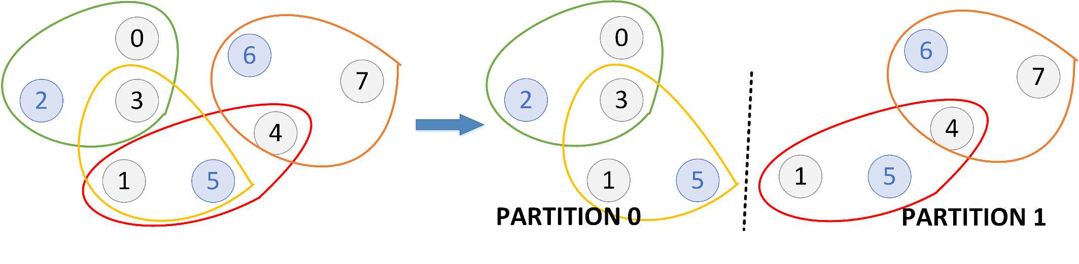
Replication & Distributed transaction
It needs to decide for each tuple whether it is better to 1) replicate it across multiple nodes (read can be performed locally, reduce the distributed transactions) and pay the cost for distributed updates or to 2) place it in a single node and pay the cost for distributed transactions.

Slide 24
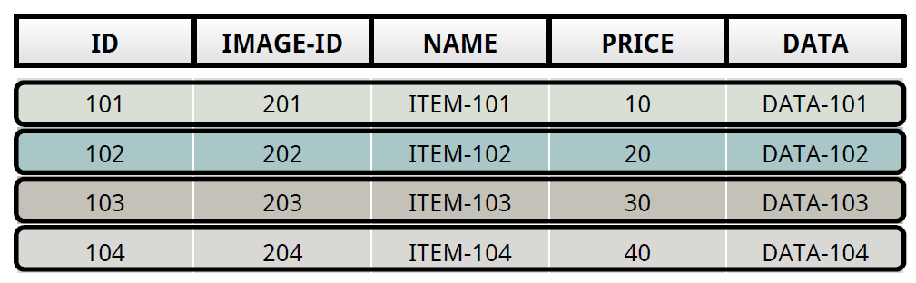
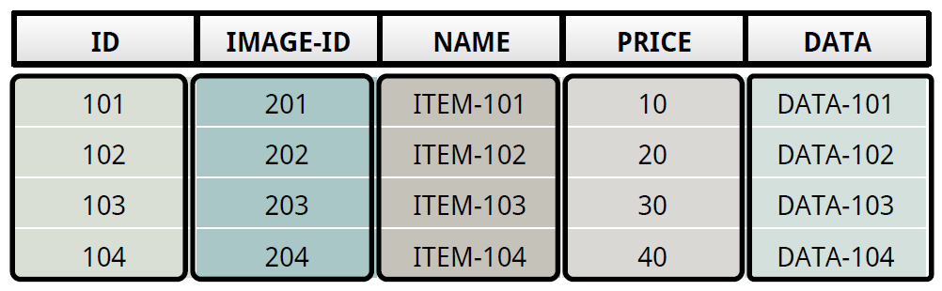
Layouts (1)
Row-store (OLTP):
Column-store (OLAP):

Slide 25
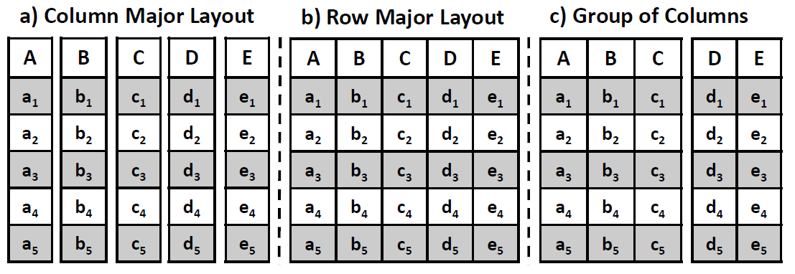
Layouts (2)
Select a+b+c f rom R where d<v1 and e>v2;
Hybrid-store (OLAP):

Slide 26
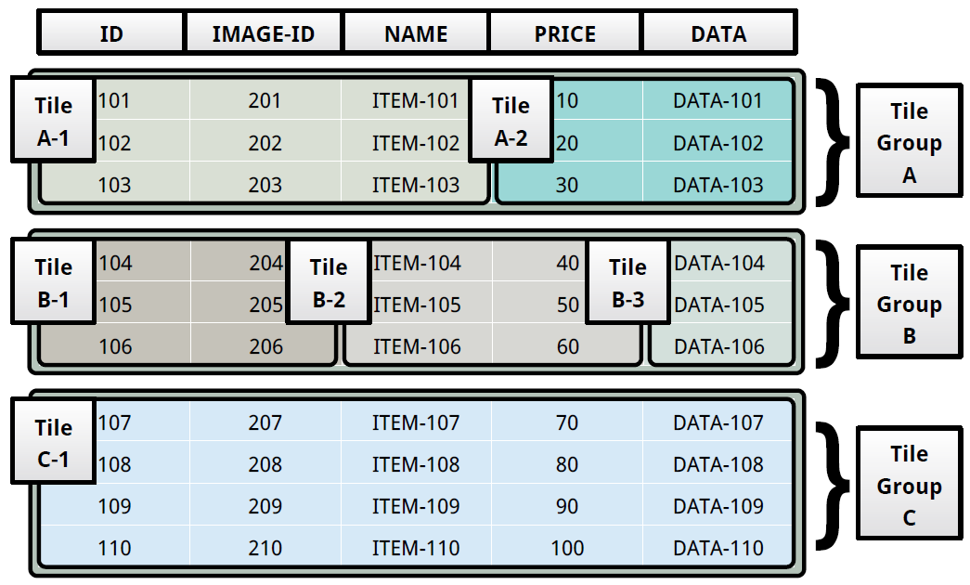
Layouts (3)
Hybrid-store (HTAP):

Slide 27
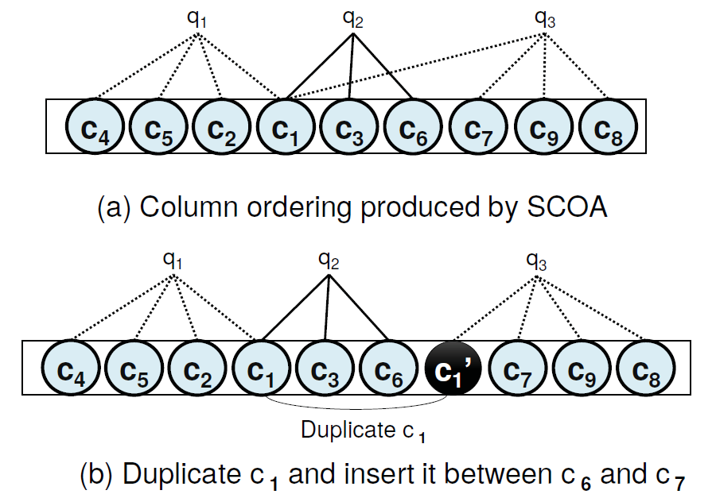
Layouts (4)
Wide table, Row-store, Column ordering

Slide 28
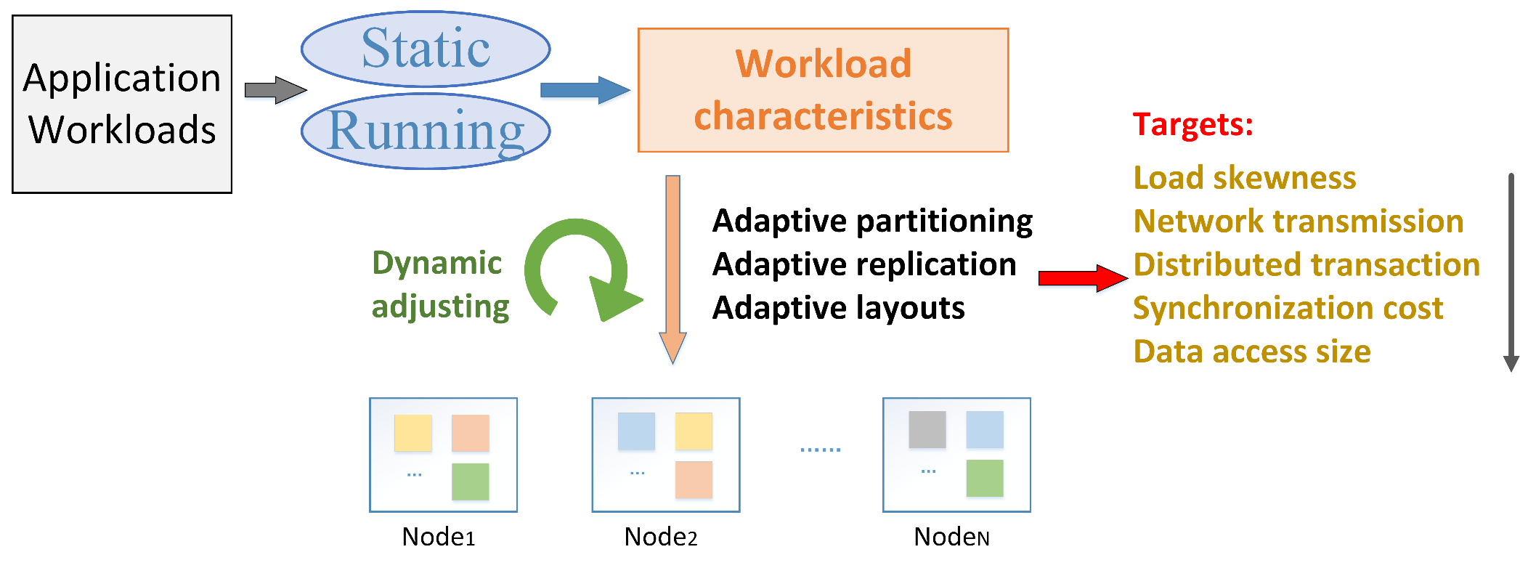
Workload-Aware Storage

Slide 29
Presentation List (1)
Zhang Tao, 4/25
Skew-Aware Automatic Database Partitioning in Shared-Nothing, Parallel OLTP Systems (SIGMOD 12)
E-Store: Fine-Grained Elastic Partitioning for Distributed Transaction Processing Systems (VLDB 14)
Adaptive partitioning -> load skewness, distributed transaction
Zhang Yanfei, 5/2
Schism: a Workload-Driven Approach to Database Replication and Partitioning (VLDB 10)
SWORD: workload-aware data placement and replica selection for cloud data management systems (EDBT 13)
Adaptive partitioning & replication -> distributed transaction

Slide 30
Presentation List (2)
Zhang Xiaolei, 5/9
Amoeba: A Shape changing Storage System for Big Data (VLDB Demo 16)
AdaptDB: Adaptive Partitioning for Distributed Joins (VLDB 17)
Locality-aware Partitioning in Parallel Database Systems (SIGMOD 15)
Adaptive partitioning -> network transmission
Zhang Chunxi, 5/16
H2O: A Hands-free Adaptive Store (SIGMOD 14)
Bridging the Archipelago between Row-Stores and Column-Stores for Hybrid Workloads (SIGMOD 16)
Wide Table Layout Optimization based on Column Ordering and Duplication (SIGMOD 17)
Adaptive layouts -> data access size

Slide 31
Thanks! Q & A

